Slide 1
MIXTURE PROBLEM
Rate problem based on first order equations
By:
Bhawna Saini, Deepika ,Deepti Sharma
Devashi Singh, Diksha Singala , Divya Singh
Jyoti , Kiran Negi , Kratika

Slide 2
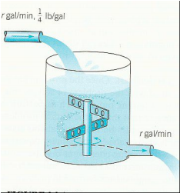
Introduction to Mixture Problem
It is a rate problem in which the quantity of a certain substance is determined at a certain time when
it is poured in a mixture in a container at a particular rate
and that mixture simultaneously flows out of that container at some certain rate.
Provided, the mixture is kept uniform by stirring.

Slide 3
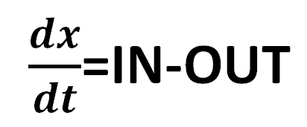
Formula for Mixture Problem
Suppose a substance S is being poured in a mixture in a container at a certain time and the mixture is simultaneously flowing out of the container at a certain rate.
If, ->x denotes the quantity of S at time t, ->dx/dt denotes the rate of change of x with respect to t, ->IN denotes the rate of S entering the mixture and ->OUT denotes the rate of mixture flowing out, then
To determine x of S at time t

Slide 4
SOME DEMONSTRATIONS AND EXAMPLES

Slide 5
Demonstration : 1
Example 1(page 94) :
A tank initially contains 50 gal of pure water. Starting at time t=0 a brine containing 2 lb. of dissolved salt per gallon flows into the tank at the rate of 3 gal/min. The mixture is kept uniform by stirring and the well-stirred mixture simultaneously flows out of the tank at the same rate.
1. How much salt is in the tank at any time t>0?
2. How much salt is present at the end of 25 min?
3. How much salt is present after a long time?

Slide 6
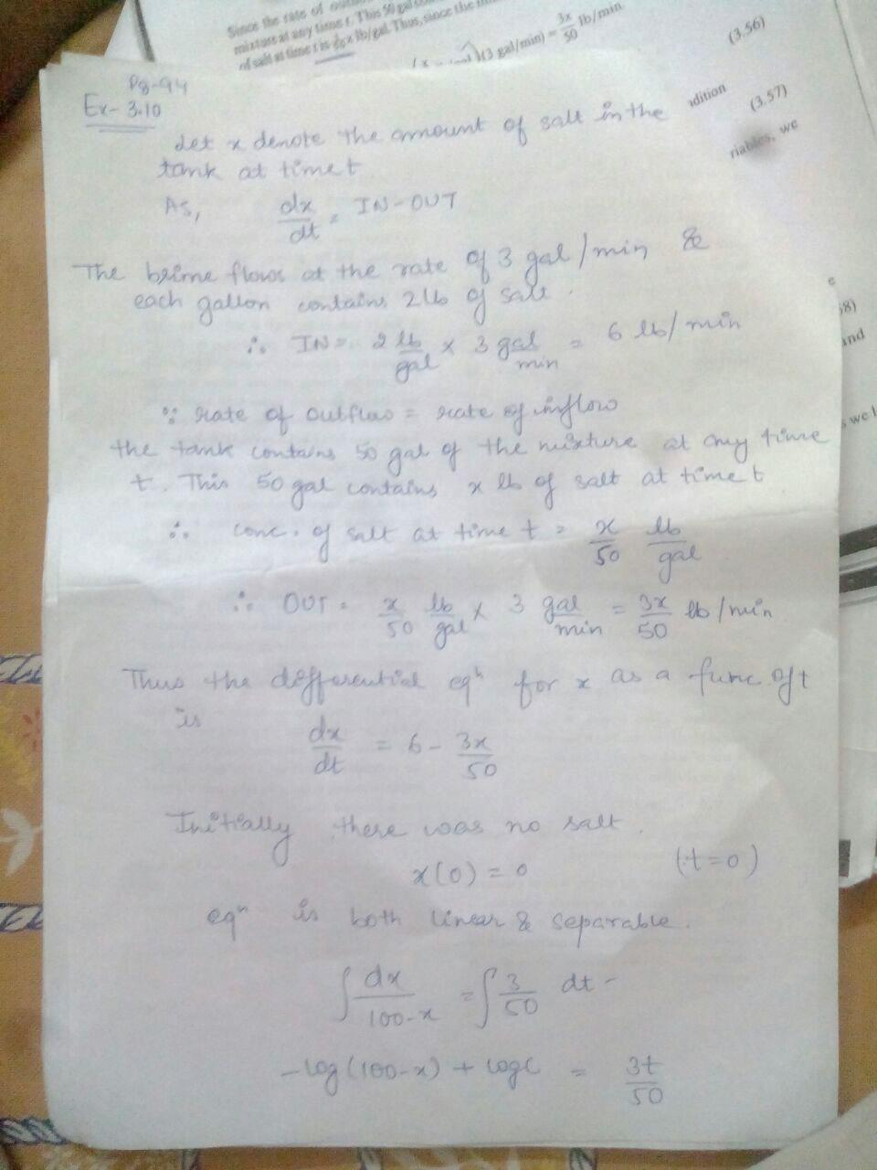

Slide 8
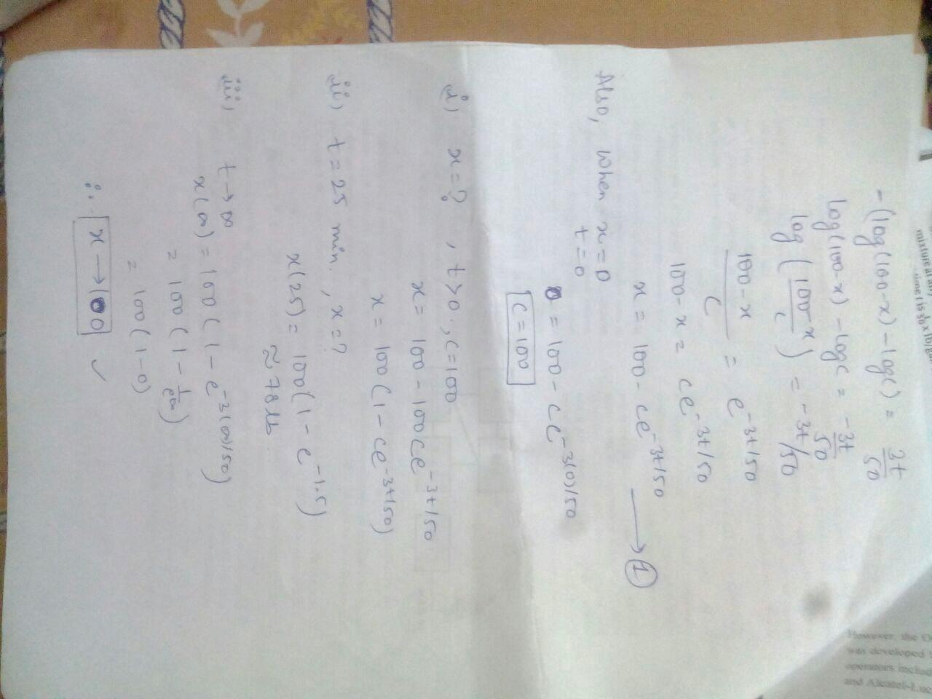

Slide 10
DEMONSTRATION 2:
Example 2(page 96)
A large tank initially contains 50 gal of brine in which there is dissolved 10 lb. of salt. Brine containing 2 lb. of dissolved salt per gallon flows into the tank at the rate of 5 gal/min. The mixture is kept uniform by stirring, and the stirred mixture simultaneously flows out at the slower rate of 3 gal/min. How much salt is in the tank at any time t>0 ?

Slide 11
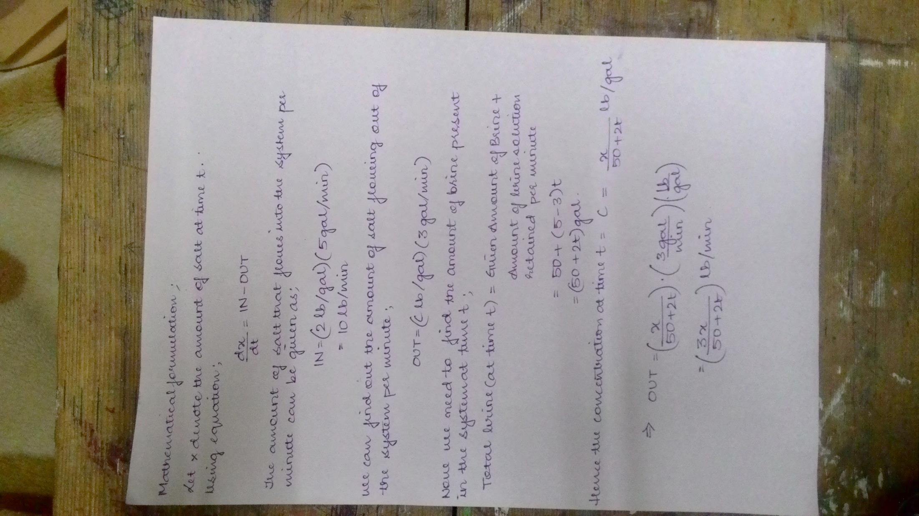

Slide 13
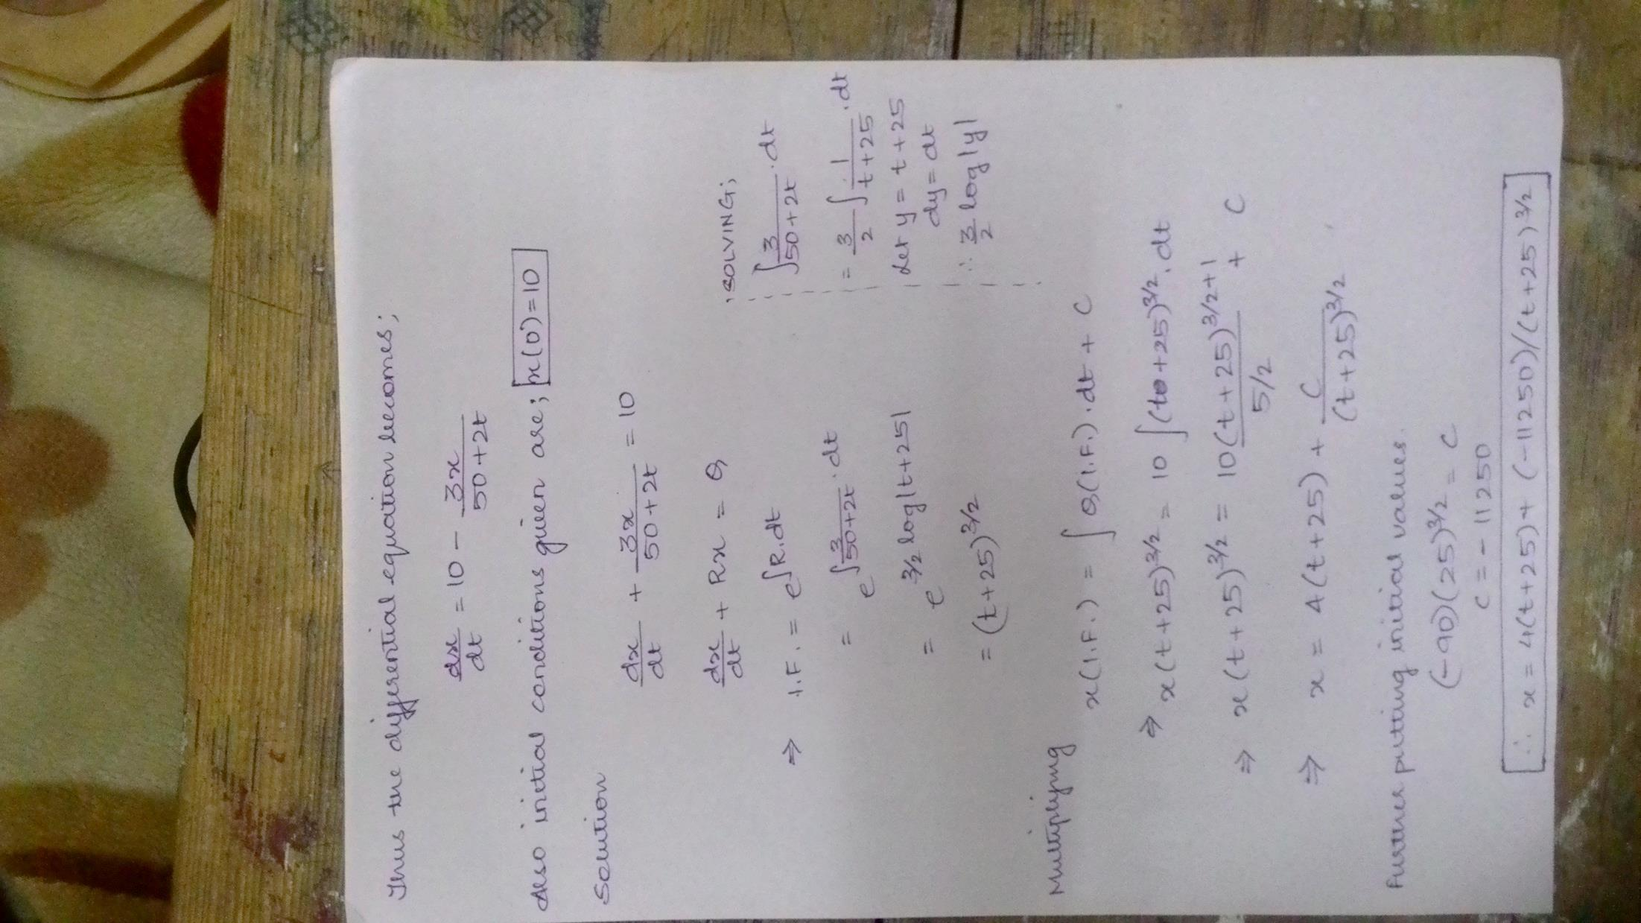

Slide 15
DEMONSTRATION 3:
Question 17 ( page 100)
A tank initially contain 100 gal of pure water. starting at t=0,a brine containing 4 lb. of salt per gallon flows into the tank at the rate of 5 gal/min. the mixture is kept uniform by stirring and well –stirred mixture flows out at the slower rate of 3 gal/min.
a) how much salt is in the tank at the end of 20 minutes?
b) When is there 50 lb. of salt in the tank?

Slide 16
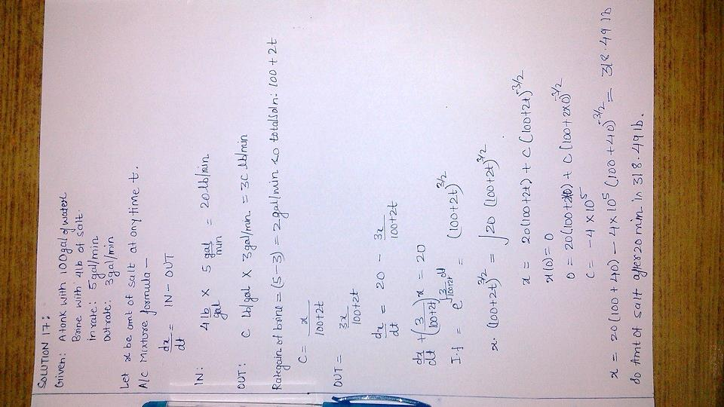

Slide 18
DEMONSTARTION 4:
Question 15 (page 100)
A tank initially contains 100 gal of brine in which there is dissolved 20 lb. of salt. Starting at time t=0 , brine containing 3 lb. of dissolved salt per gallon flows into the tank at the rate of gal/min. The mixture is kept uniform by stirring and the well-stirred mixture simultaneously flows out of the tank at the same rate.
How much salt is in the tank at the end of 10 min?
When is there 160 lb. of salt is in the tank?

Slide 19
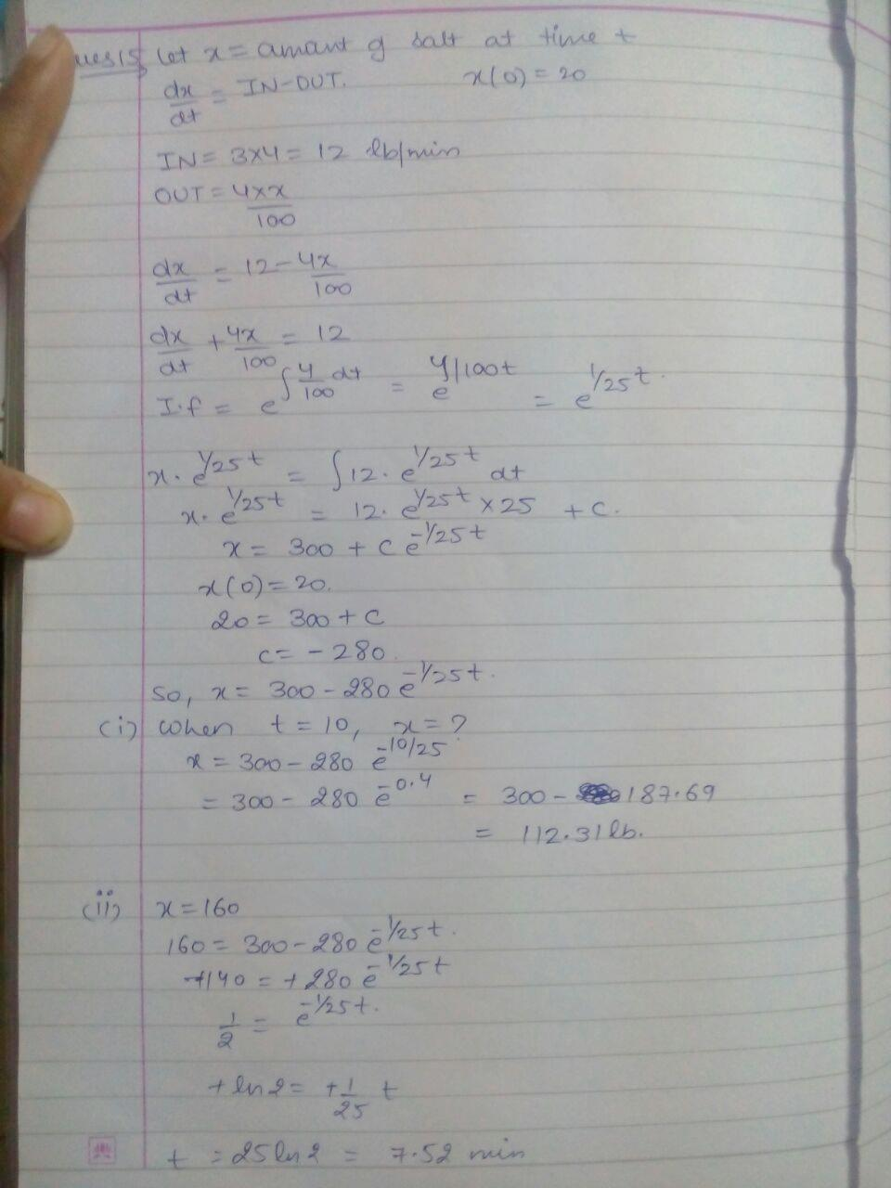

Slide 21
Uses and Scopes of the Mixture Problem

Slide 22

1.NEWTON’S LAW OF COOLING:
The rate at which the temperature t(t) changes in a cooling body at time t is proportional to the difference between the temperature of the body, t(t) and the constant temperature t_{a} of the surrounding medium.
Problems based on the Newton's law of cooling :
Prediction of time of death (in a homicide case)
Determination of time required by a plastic mixture to cool down
Designing of cooling and heating system of a manufacturing facility.

Slide 23
2. MIXTURE PROBLEM:
Start with a substance that is dissolved in a liquid.
Liquid will be entering and leaving a holding tank.
The liquid entering the tank may or may not contain more of the substance dissolved in it.
Liquid leaving the tank will of course contain the substance dissolved in it.
If Q(t) gives the amount of the substance dissolved in the liquid in the tank at any time t we want to develop a differential equation that, when solved, will give us an expression for Q(t).
Problems based on Mixture Problem:
Consider air as a liquid and u can predict the levels of various components dissolved in it.

Slide 24
3.TOLRANCE ALLOCATION PROBLEMS
The response surface methodology (RSM) approach can be used to determine the optimal component tolerances in an assembly.
Frequently, response surface designs such as Box-Behnken design and central composite design are used in tolerance allocation problems.
But mixture experiments, which are essentially constructed for designing a blend composition, can also be used instead of response surface designs in order to observe the cost values.

Slide 25
Thank you !

